Slide 1
Host Header Injection Testing
Using BurpSuite Community Edition | PortSwigger Web Security Academy | Severity: HIGH
⚠ SEVERITY: HIGH — Immediate Action Required
MOHAMMED ALI
CYBERSECURITY & ETHICAL HACKING

Slide 2
Agenda
01 Introduction to Host Header Injection
Understanding the vulnerability, attack surface, and exploitation mechanics
02 Lab Environment & Tools Setup
BurpSuite Community Edition, Proxy, Repeater, PortSwigger Academy labs
03 BurpSuite Workflow & Traffic Interception
Proxy configuration, HTTPS interception, HTTP History capture
04 Host Header Manipulation Testing
Direct Host header injection, exploit server domain poisoning
05 X-Forwarded-Host & Duplicate Header Testing
Advanced injection vectors and parsing ambiguity exploitation
06 Exploit Server Validation
Attacker-controlled domain simulation and response confirmation
07 Key Findings & Risk Analysis
Severity assessment, risk matrix, and exploitability evaluation
08 Mitigation Strategies & Conclusion
Remediation recommendations and security hardening guidance

Slide 3
Introduction — Host Header Injection
What Is Host Header Injection?
HTTP Host header is mandatory in every HTTP/1.1 request
Servers use it for routing, URL generation, and access control
Attacker replaces it with a malicious domain to influence server behavior
Most dangerous in security-sensitive operations like password reset
Key Attack Scenarios
Password Reset Poisoning — steal reset tokens via email
Web Cache Poisoning — serve malicious cached content
Reverse Proxy Confusion — misroute backend requests
Server-Side Request Forgery (SSRF) — access internal services
Password Reset Poisoning — Attack Chain
▶ Step 1: Victim clicks "Forgot Password" on login page
▶ Step 2: Attacker intercepts the request in BurpSuite Proxy
▶ Step 3: Host header replaced with attacker-controlled domain
▶ Step 4: Application builds reset URL using the injected Host
▶ Step 5: Victim receives poisoned reset email with attacker URL
▶ Step 6: Victim clicks link — token delivered to attacker server
▶ Step 7: Attacker resets password — full account takeover

Slide 4
Tools & Environment Setup
BurpSuite Community Edition
Primary man-in-the-middle proxy for intercepting, inspecting, and modifying HTTP/S traffic in real time.
BurpSuite Proxy Module
Captures all browser traffic via 127.0.0.1:8080, enabling live inspection and modification of requests/responses.
BurpSuite Repeater Module
Allows manual modification and repeated re-sending of captured HTTP requests — used for all payload injection tests.
PortSwigger Web Security Academy
Provides intentionally vulnerable lab environments for realistic, legal penetration testing practice with real CVE scenarios.
Exploit Server (PortSwigger)
Attacker-controlled domain and server used to simulate Host header poisoning — logs incoming requests with tokens.
Burp Chromium Browser
Pre-configured browser with automatic proxy routing through BurpSuite — no manual proxy setup required.

Slide 5
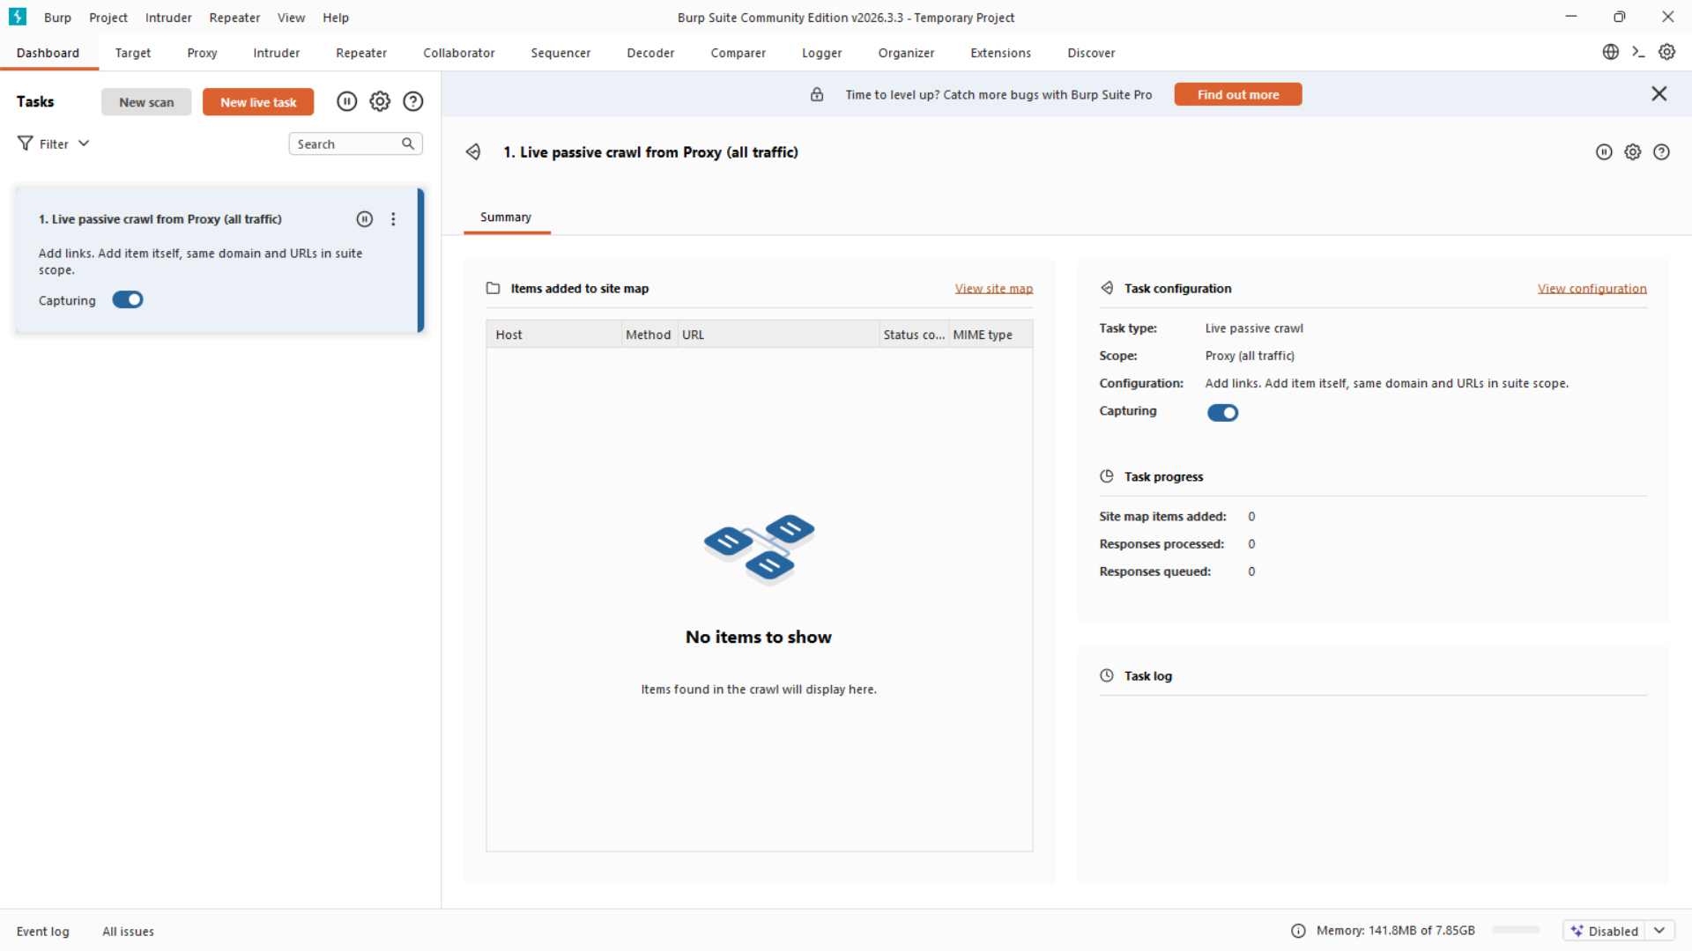
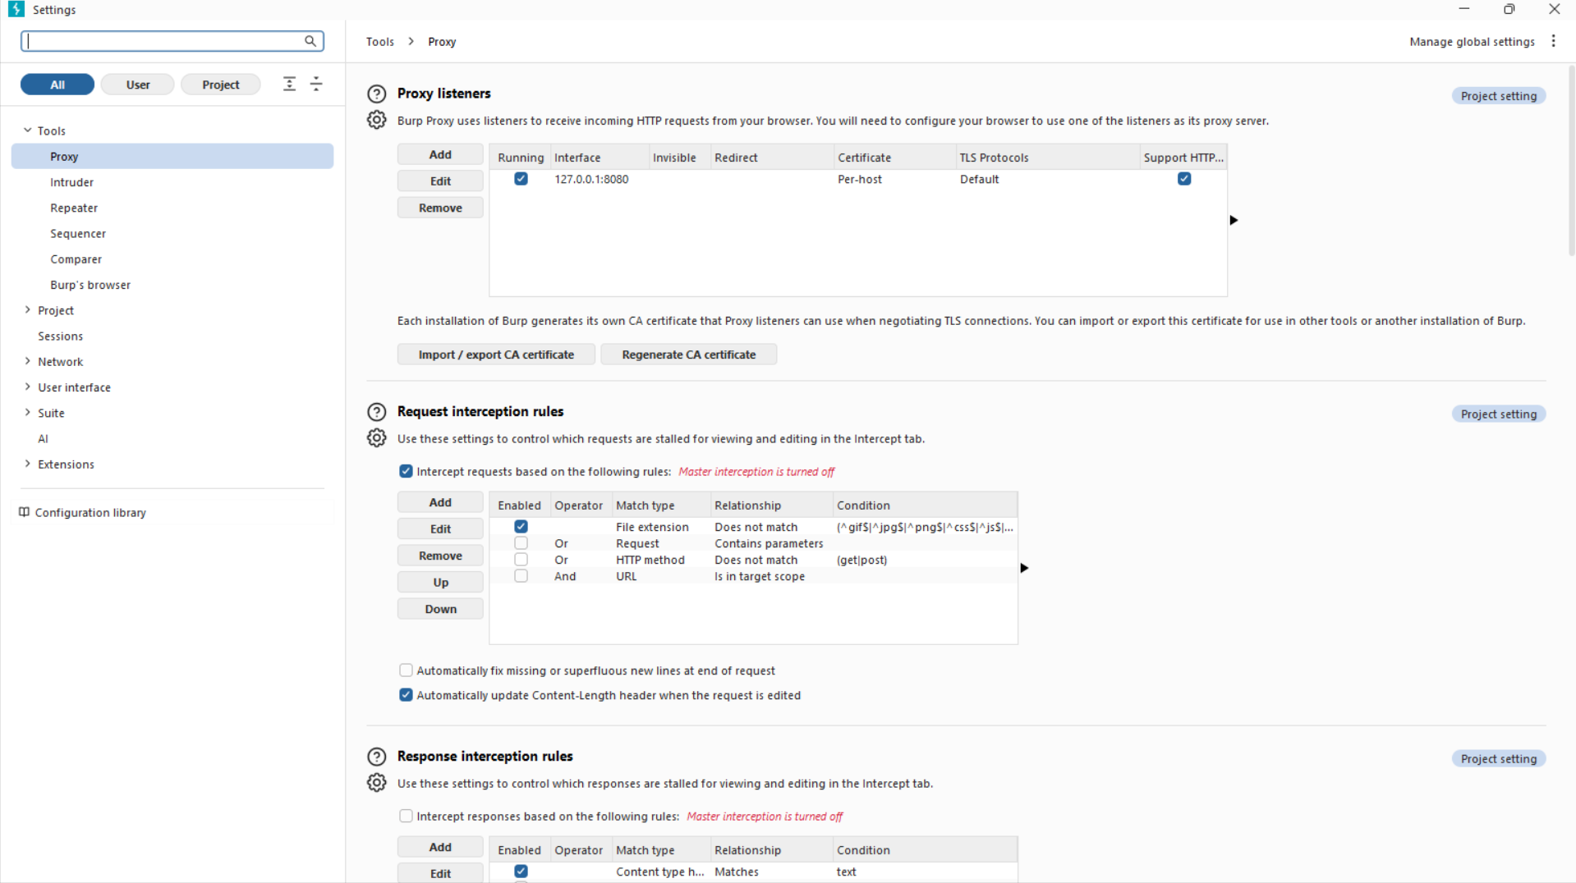
Phase 1 — BurpSuite Configuration & Proxy Setup
Figure 1: BurpSuite Community Edition — Dashboard showing proxy listener active on 127.0.0.1:8080
Figure 2: Proxy Listener Settings — Port 8080, loopback interface, all interfaces option enabled
Dashboard Overview:
Proxy tab confirms listener running on port 8080
Intercept set to ON to capture all outgoing browser requests
HTTP History tab records every captured request/response pair
Proxy Listener Configuration:
Listener bound to 127.0.0.1:8080 for local traffic capture
Certificate trusted by Burp Chromium Browser automatically
HTTPS traffic decrypted and inspectable in plaintext

Slide 6
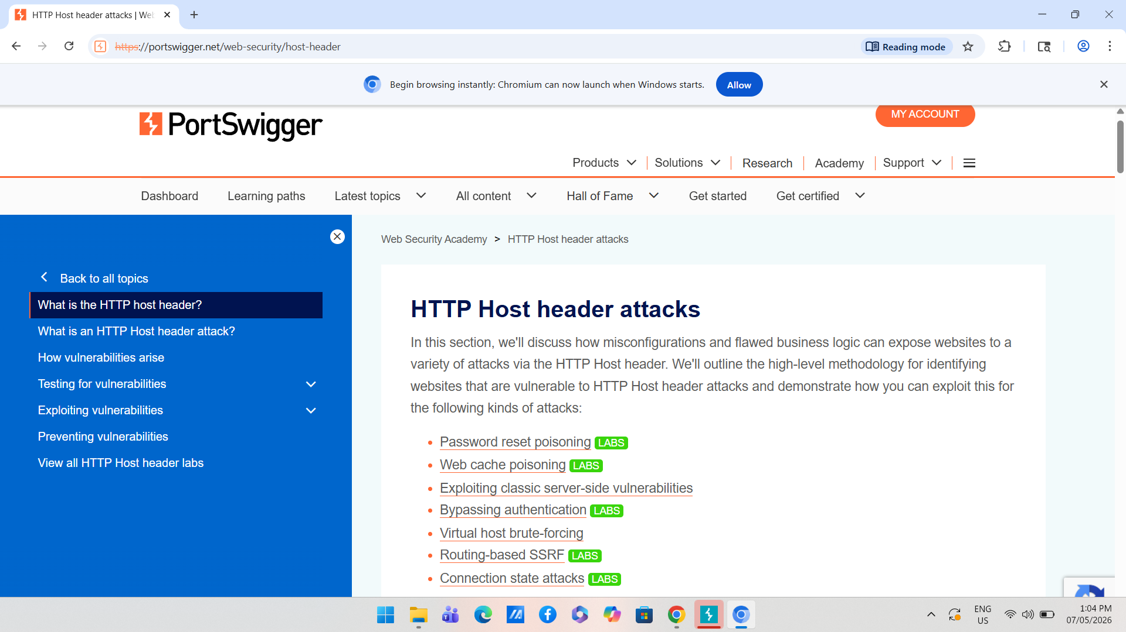
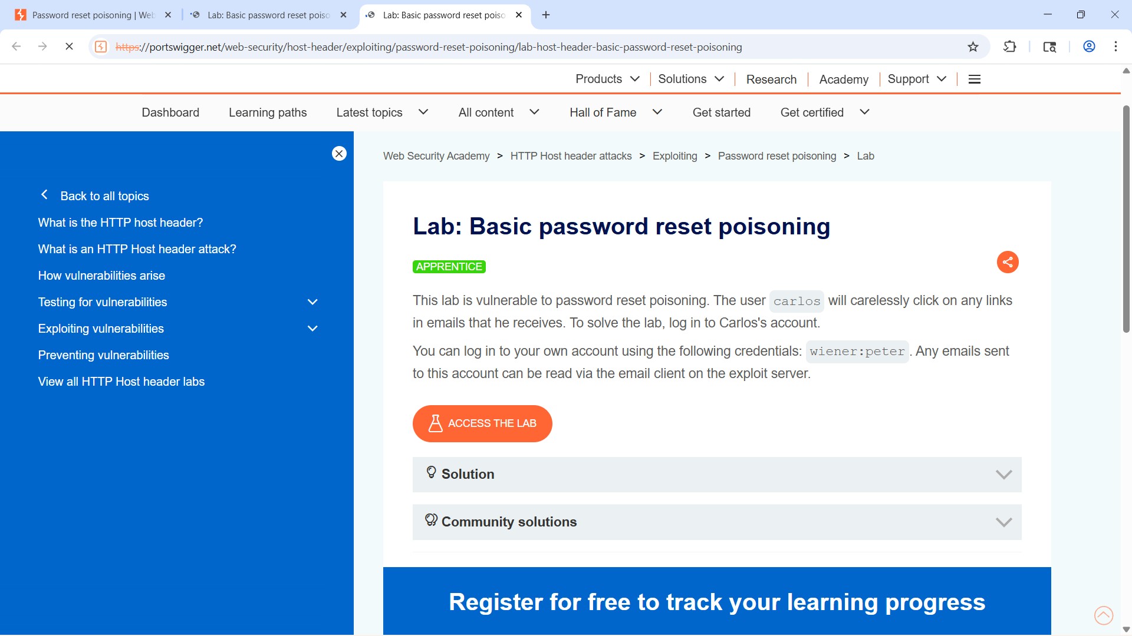
Phase 1 — Accessing Host Header Injection Labs
Figure 3: PortSwigger Web Security Academy — Host Header Injection lab category listing
Figure 4: Basic Password Reset Poisoning Lab — APPRENTICE level, target application loaded
Lab Environment:
PortSwigger Academy provides intentionally vulnerable labs
Host Header Injection section lists multiple exploitable scenarios
Labs include: password reset poisoning, cache poisoning, SSRF
Target Lab Details:
Lab: Basic password reset poisoning (APPRENTICE level)
Victim user: carlos — clicks any link received by email
Exploit server available to capture poisoned requests

Slide 7
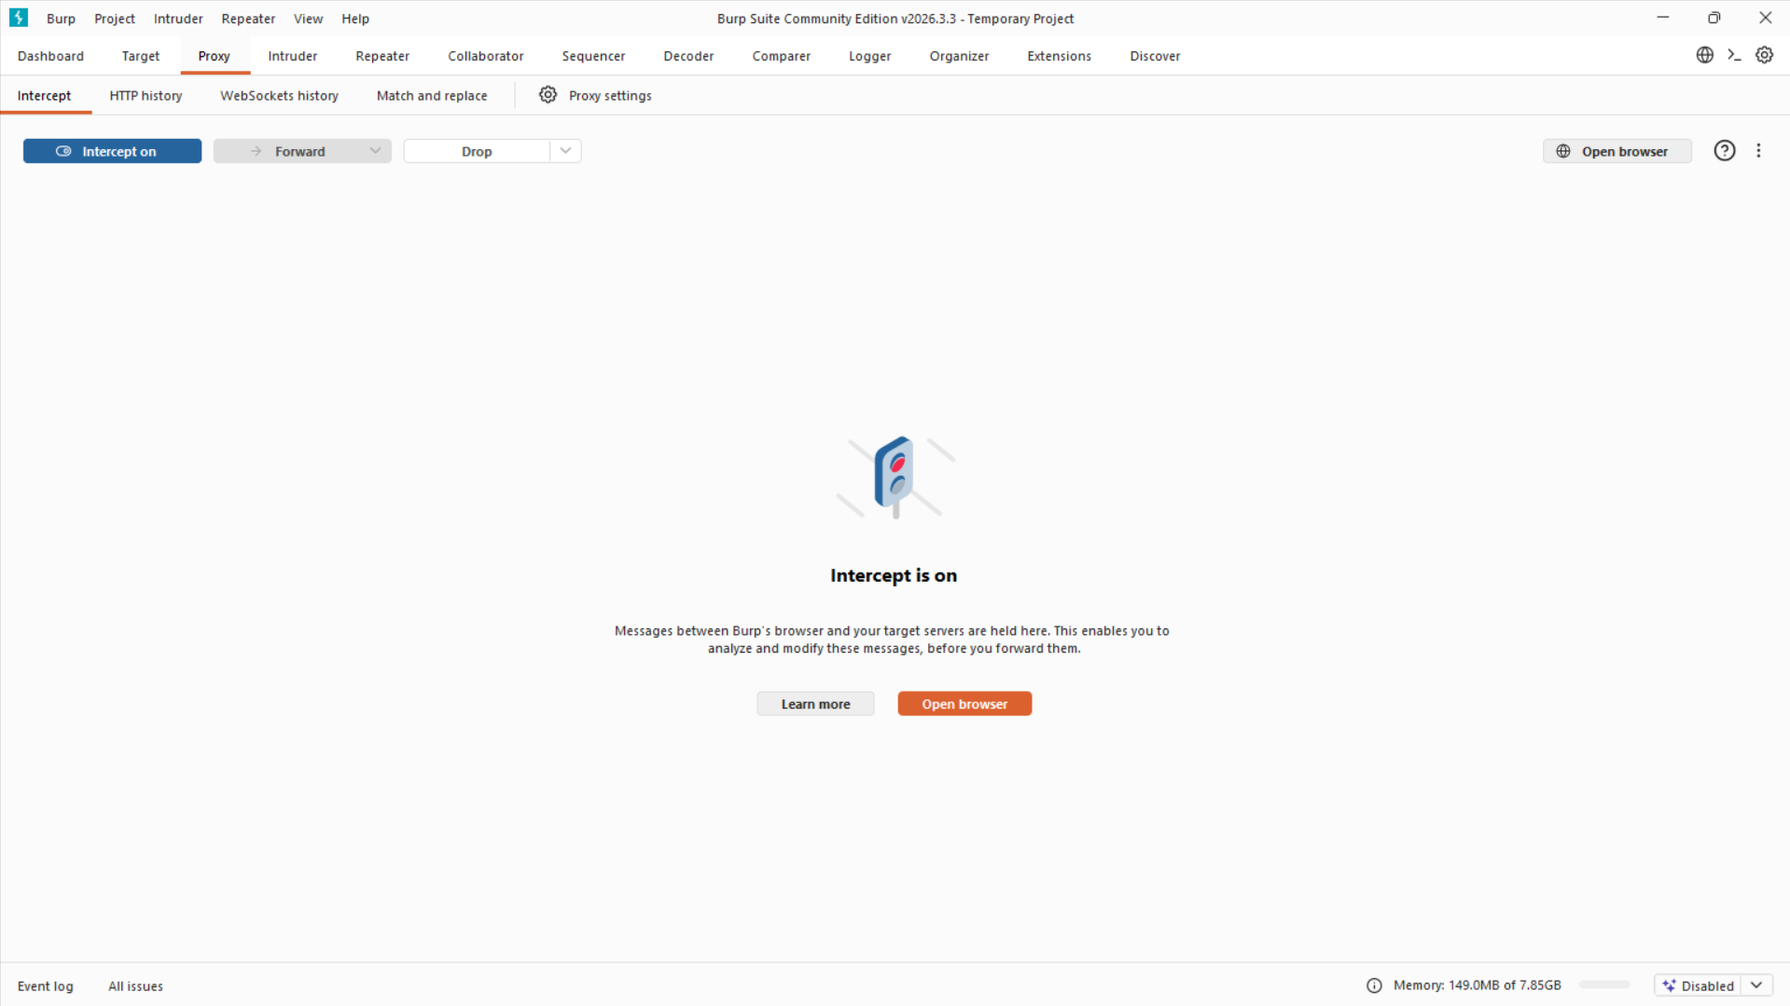
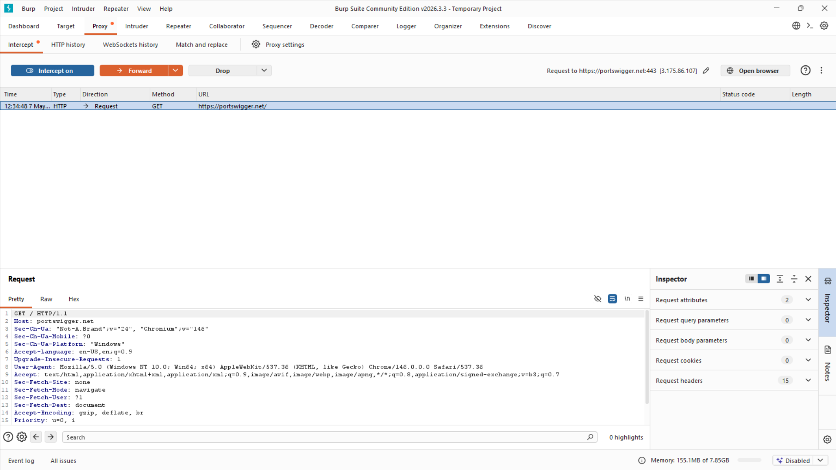
Phase 2 — Traffic Interception & Request Capture
Figure 5: Intercept ON — BurpSuite capturing live POST /forgot-password request mid-flight
Figure 6: Intercepted HTTP Request — Host header clearly visible, request forwarded to Repeater
Interception Step:
Intercept enabled before submitting the forgot password form
POST /forgot-password request paused and held in Burp Proxy
Full request headers and body visible including Host header value
Request Analysis:
Host: 0a80...web-security-academy.net (legitimate baseline)
POST body contains: username=carlos (victim account)
Request forwarded to Repeater for controlled manipulation

Slide 8
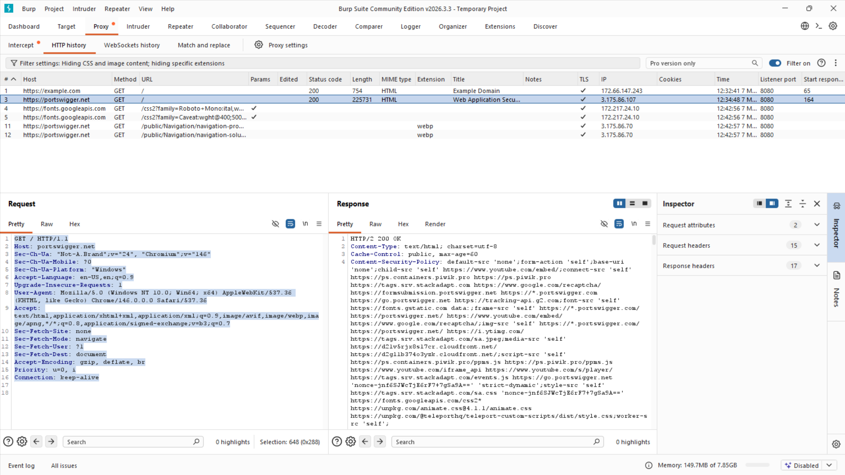
Phase 2 — HTTP Request Analysis in BurpSuite
Figure 7: Full HTTP Request Analysis — Burp Proxy showing request headers, Host value, response, and Inspector panel side by side
Key Observations from Request Analysis:
Host header value is the primary injection point identified for manipulation
Content-Type: application/x-www-form-urlencoded | POST body: username=carlos
HTTP History tab confirms the request was captured and logged for analysis
Request structure forwarded to Repeater for systematic payload testing

Slide 9
Phase 3 — Host Header Manipulation Payloads
Payload 1 — Generic Attacker Domain
POST /forgot-password HTTP/2
Host: attacker.com
Content-Type: application/x-www-form-urlencoded
username=carlos
Result: HTTP/2 200 OK — Request Accepted
Testing Results
Confirmed Vulnerability:
Server returned HTTP/2 200 OK for both payloads
Password reset processed with attacker.com as Host
Exploit server domain accepted without restriction
No validation or whitelisting of Host header detected
Attack Impact:
Generated reset link would embed attacker domain
Victim email contains poisoned URL to attacker server
Token captured — full account takeover possible
Payload 2 — Exploit Server Domain
POST /forgot-password HTTP/2
Host: exploit-0a5e009403844d5b.exploit-server.net
Content-Type: application/x-www-form-urlencoded
username=carlos
Result: HTTP/2 200 OK — Exploit Server Accepted

Slide 10
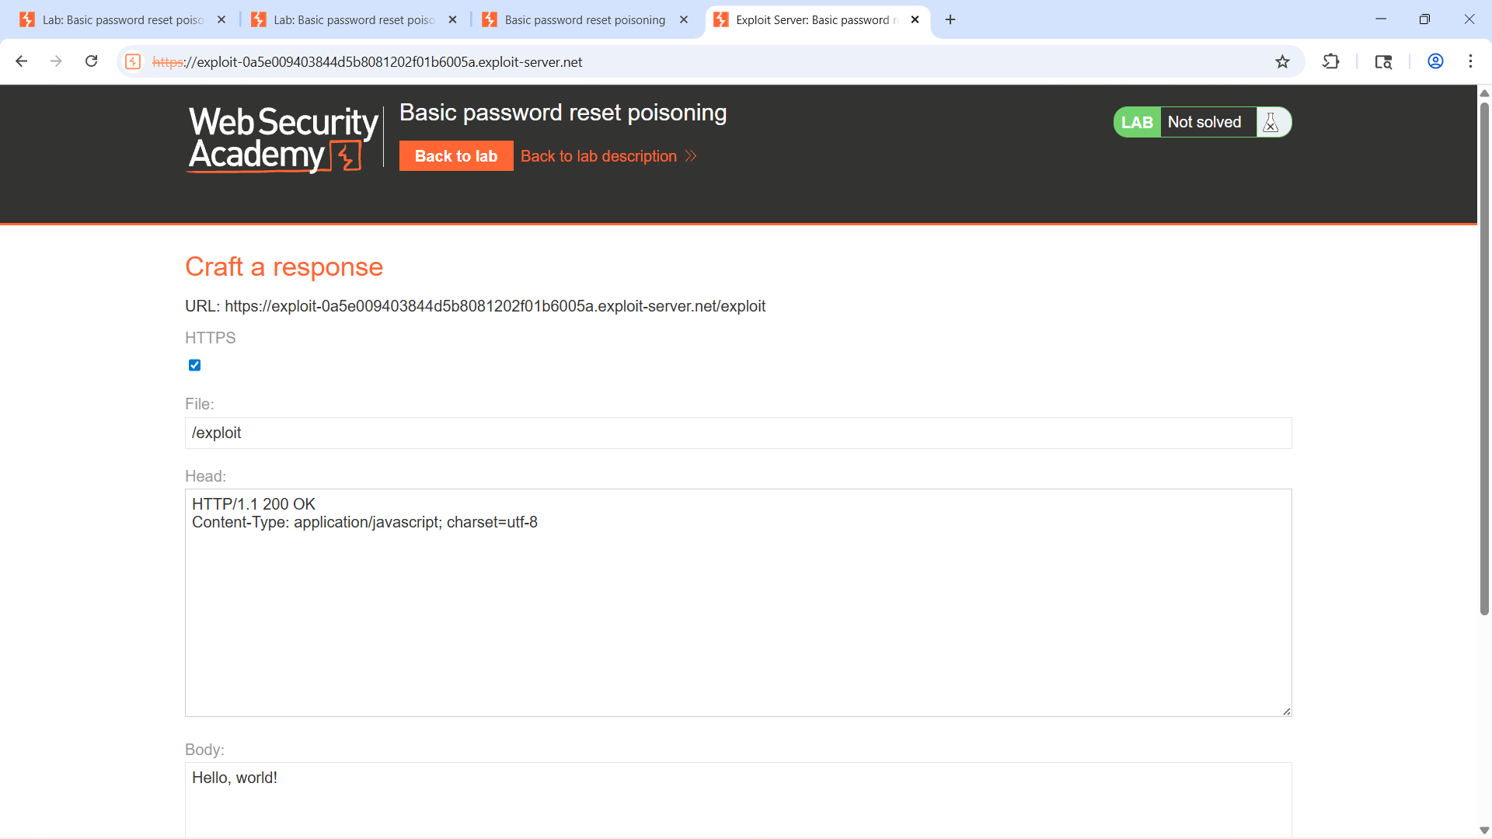
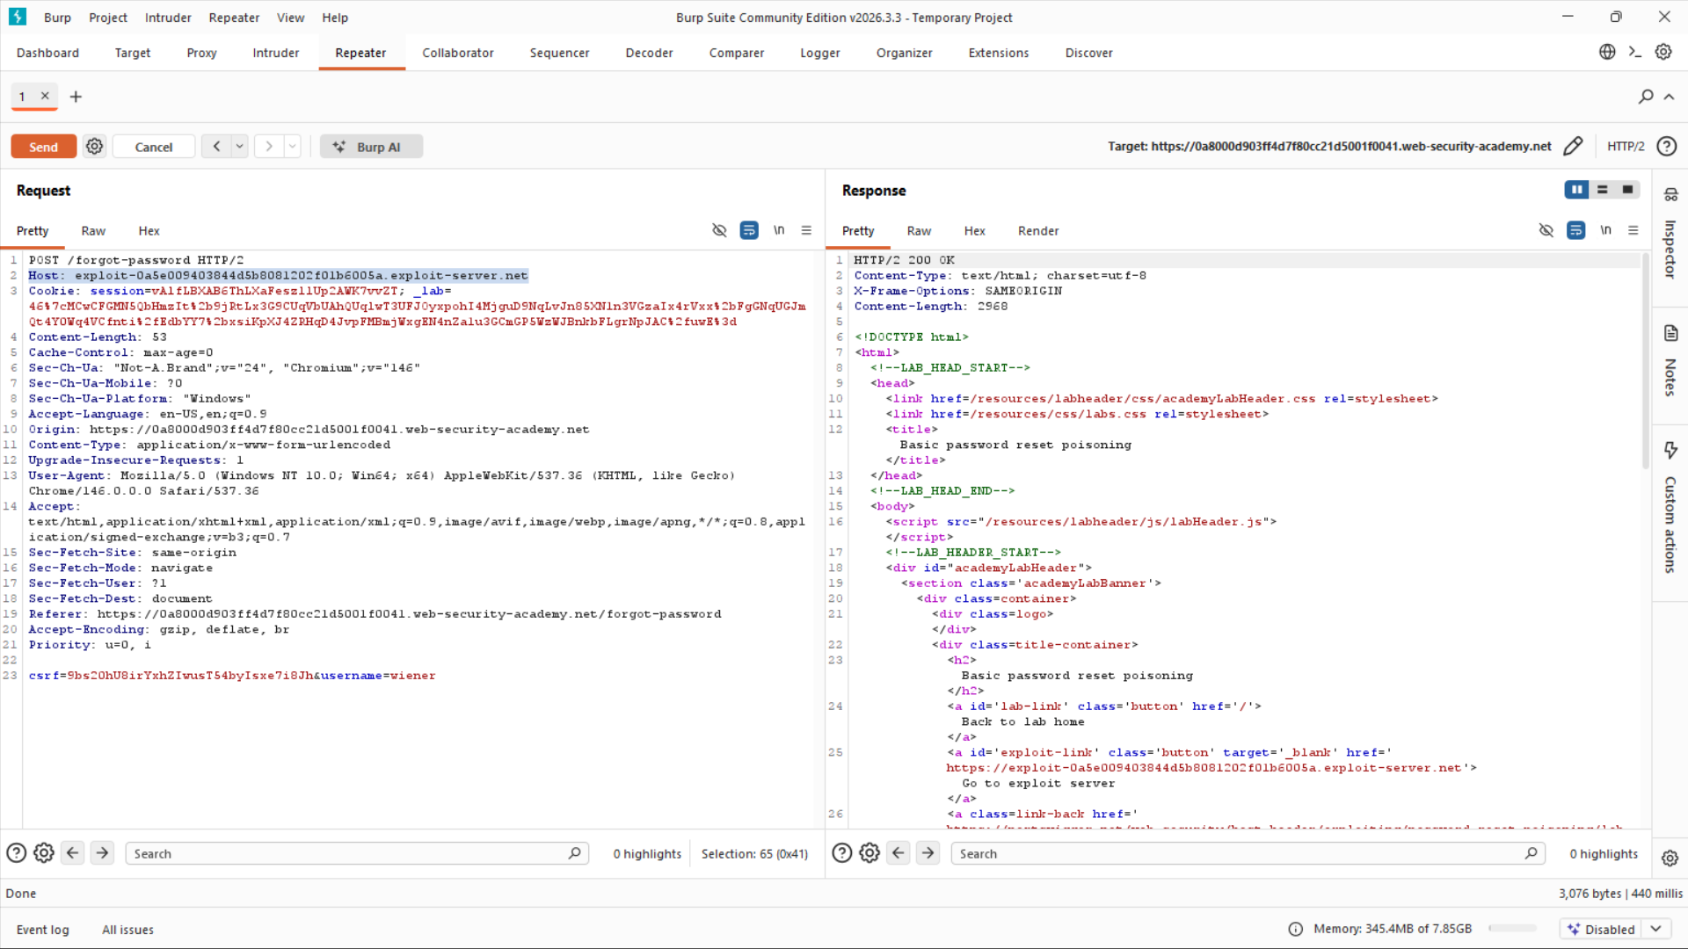
Phase 3 — Exploit Server Validation (Screenshots)
Figure 8: PortSwigger Exploit Server — attacker domain configured, /exploit path set as response handler
Figure 9: BurpSuite Repeater — exploit server domain injected as Host, HTTP/2 200 OK response confirmed
Exploit Server Setup:
PortSwigger provides attacker-controlled server for testing
Server URL injected as Host header value in Repeater
Any request hitting exploit server is logged with full details
Confirms token delivery if victim clicks poisoned reset link
Repeater Injection Result:
Request modified: Host: exploit-0a5e...exploit-server.net
Server response: HTTP/2 200 OK — request processed normally
Exploit server received the poisoned reset request successfully
Vulnerability confirmed — password reset poisoning is exploitable

Slide 11
Phase 4 & 5 — Advanced Header Injection Testing
X-Forwarded-Host Header Injection (Payloads 3 & 4)
Host: [legitimate-lab-domain]
X-Forwarded-Host: attacker.com
Also tested with exploit server domain:
X-Forwarded-Host: exploit-0a22...exploit-server.net
Result: HTTP/2 200 OK — Both payloads accepted!
Why These Attacks Are Critical
X-Forwarded-Host Attack Surface:
Many backends trust this header blindly when deployed behind reverse proxies
Extends Host injection even when primary Host header is monitored or filtered
Allows poisoning without modifying the visible Host header
Duplicate Header Exploit Path:
RFC 7230 does not define consistent behavior for duplicate Host headers
Reverse proxy processes first Host; backend application may use second
Enables cache poisoning — subsequent users receive attacker-injected content
Duplicate Host Header Test (Payload 5)
Host: [legitimate-lab-domain] ← Front-end sees this
Host: attacker.com ← Backend may use this
Result: Abnormal / inconsistent server response
Parsing ambiguity confirmed between proxy and backend

Slide 12
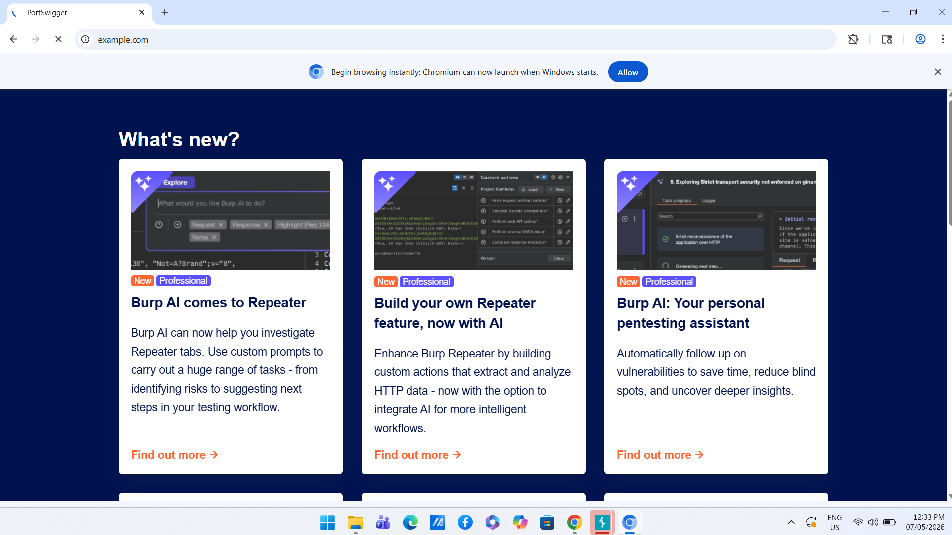
Phase 6 — Final Validation & Comparative Testing
Figure 10: BurpSuite Chromium Browser — Integrated browser confirming proxy routing before final validation test round
Final Validation Comparison — Confirming Root Cause:
Manipulated Host (attacker.com): server hung / became unresponsive or returned blank — injection confirmed
Valid Host (legitimate domain): HTTP/2 200 OK immediately — baseline behavior normal and stable
Differential response confirms Host header handling is the direct root cause — vulnerability fully validated

Slide 13
Key Findings Summary
01
Arbitrary Host Values Accepted
Application accepted attacker.com and exploit server domain with no whitelist validation or rejection mechanism.
02
Password Reset Poisoning Confirmed
Functionality continued processing after Host manipulation — full poisoning chain verified end to end.
03
X-Forwarded-Host Not Validated
Forwarded header accepted without restriction — attack surface extends beyond the primary Host header.
04
Duplicate Header Parsing Ambiguity
Two Host headers produced abnormal responses — confirms reverse proxy confusion and cache poisoning risk.
05
Baseline Behavior Confirmed Normal
Valid Host header produced stable HTTP/2 200 OK — all anomalies isolated directly to injected payloads.
OVERALL SEVERITY: HIGH — Immediate remediation recommended across all identified vectors

Slide 14
Risk Analysis — Impact & Likelihood Assessment
Risk Vector
Potential Impact
Impact
Likelihood
Severity
Password Reset Poisoning
Full account takeover via stolen reset token
Critical
High
HIGH
Credential Theft
Attacker captures login credentials from poisoned links
Critical
High
HIGH
Phishing via Poisoned Links
Victims receive malicious emails appearing legitimate
High
High
HIGH
Reverse Proxy Confusion
Requests misrouted to unintended internal backends
Medium
Medium
MED
Web Cache Poisoning
Malicious content served to multiple users via cache
High
Medium
MED
Authentication Manipulation
Session and auth flow subverted via header injection
Critical
Medium
HIGH

Slide 15
Mitigation Strategies
01 Strict Host Header Whitelisting
Validate every incoming Host header against a pre-approved list. Reject requests with unknown Host values — return 400 Bad Request immediately.
02 Strip Untrusted Forwarded Headers
Configure reverse proxy to drop X-Forwarded-Host, X-Host, and similar headers from external clients before they reach the backend application.
03 Block Duplicate Host Headers
Configure Nginx/Apache/IIS to reject requests containing more than one Host header. Enforce strict RFC 7230 compliance at the server layer.
04 Hard-code Base URLs in Config
Generate reset links and email URLs from server-side configuration only. Never derive the domain from the incoming Host header value dynamically.
05 Harden Reverse Proxy Rules
Normalize headers at the proxy layer. Drop requests that do not match expected routing patterns. Audit all proxy configurations regularly.
06 Security Logging & Alerting
Log and alert on Host values not matching the canonical domain. Monitor for repeated manipulation attempts indicating active reconnaissance.

Slide 16
Conclusion
Project Goals Achieved
Demonstrated full Host Header Injection attack chain in a controlled lab environment
Covered direct injection, X-Forwarded-Host abuse, and duplicate header scenarios
All testing conducted ethically within PortSwigger Web Security Academy
Core Security Takeaway
Never trust user-supplied Host header values in security-sensitive operations
Always whitelist, validate, and use hard-coded canonical domains for URL generation
Skills & Competencies Gained
BurpSuite Proxy, Repeater, and HTTP History professional workflows
HTTP request structure, header manipulation, and vulnerability identification
Professional penetration testing documentation and evidence reporting
Assessment Summary
Vulnerability: Host Header Injection
Severity Rating: HIGH
Affected Function: Password Reset Mechanism
Attack Vectors: 3 (Direct, X-Fwd, Duplicate)
Testing Platform: PortSwigger Web Academy
Primary Tool: BurpSuite Community Edition
Evidence Collected: 10 Screenshots + Payloads
Recommendation: Immediate Remediation

Slide 17
Questions?
Host Header Injection Testing | BurpSuite Community Edition
PortSwigger Web Security Academy | Severity: HIGH

Slide 18
Thank You!
Host Header Injection Testing | BurpSuite Community Edition | PortSwigger Web Security Academy
MOHAMMED ALI
CYBERSECURITY & ETHICAL HACKING

